Slide 1
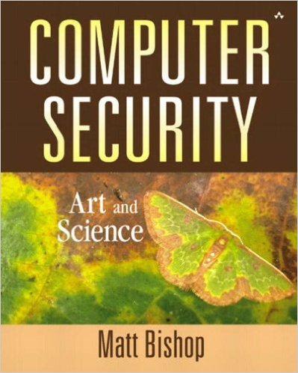
Computer and Network Security COMP 5370/637* Lecture #8 September 2, 2015
Tony Skjellum
skjellum@auburn.edu

Slide 2
Today’s Topics
Classic Cryptography
Cæsar cipher
Vigènere cipher
DES
Public Key Cryptography
Diffie-Hellman
RSA
Cryptographic Checksums
HMAC

Slide 3
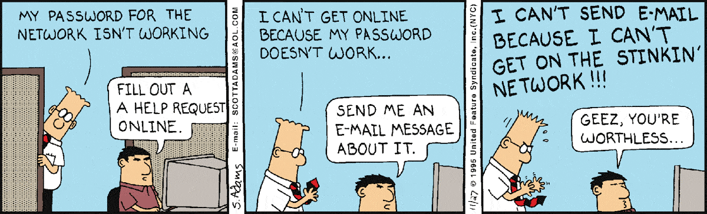
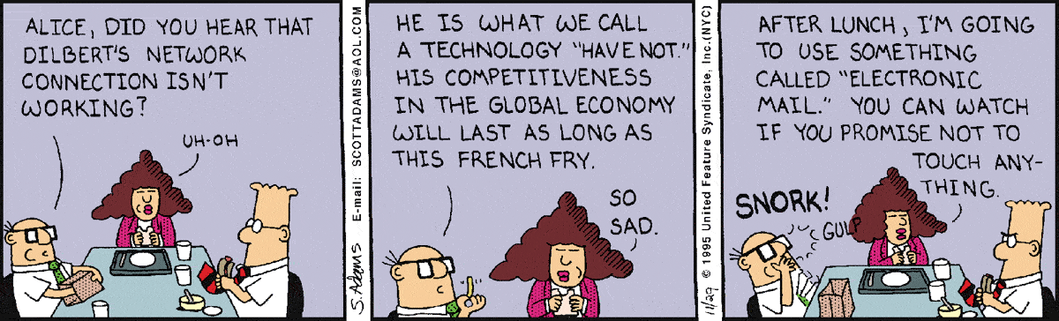
More Dilbert Security!
http://dilbert.com/search_results?terms=network

Slide 4
Other Symmetric Block Ciphers
International Data Encryption Algorithm (IDEA)
128-bit key
Each round function uses XOR, addition of 16-bit integers and binary multiplication of 16-bit integers.
These functions are combined in such a way as to produce a complex transformation that is very difficult to analyze and hence very difficult to cryptanalyze.
Subkey generation algorithm relies solely on circular shifts in a complex way in order to generate six subkeys for each round.
No table lookups or S-boxes
Notes:
http://www.quadibloc.com/crypto/co040302.htm

Slide 5
Other Symmetric Block Ciphers
Blowfish
Uses dynamic S-boxes
Subkeys and S-boxes produced by repeated application of the Blowfish algorithm to the key
A total of 521 executions of the Blowfish algorithm are required to produce subkeys and S-boxes.
not suitable for applications where secret key frequently changes
Easy to implement
High execution speed
Run in less than 5K of memory
Each new key requires pre-processing equivalent to encrypting about 4 kilobytes of text
Notes:
Blowfish keys can range from 32 to 448 bits. Preprocessing (producing subkeys) is costly, but actual encryption is fast and has a low memory footprint.

Slide 6
Blowfish Code, 1
int32_t P[18];
uint32_t S[4][256];
uint32_t f (uint32_t x) {
uint32_t h = S[0][x >> 24] + S[1][x >> 16 & 0xff];
return ( h ^ S[2][x >> 8 & 0xff] ) + S[3][x & 0xff];
}
void encrypt (uint32_t & L, uint32_t & R) {
for (int i=0 ; i<16 ; i += 2) {
L ^= P[i];
R ^= f(L);
R ^= P[i+1];
L ^= f(R);
}
L ^= P[16];
R ^= P[17];
swap (L, R);
}
http://en.wikipedia.org/wiki/Blowfish_(cipher)
Notes:
Blowfish keys can range from 32 to 448 bits. Preprocessing (producing subkeys) is costly, but actual encryption is fast and has a low memory footprint.

Slide 7
Blowfish Code, 2
void decrypt (uint32_t & L, uint32_t & R) {
for (int i=16 ; i > 0 ; i -= 2) {
L ^= P[i+1];
R ^= f(L);
R ^= P[i];
L ^= f(R);
}
L ^= P[1];
R ^= P[0];
swap (L, R);
}
{
// ...
// initializing the P-array and S-boxes with values derived from pi; omitted in the example
// ...
for (int i=0 ; i<18 ; ++i)
P[i] ^= key[i % keylen];
uint32_t L = 0, R = 0;
for (int i=0 ; i<18 ; i+=2) {
encrypt (L, R);
P[i] = L; P[i+1] = R;
}
for (int i=0 ; i<4 ; ++i)
for (int j=0 ; j<256; j+=2) {
encrypt (L, R);
S[i][j] = L; S[i][j+1] = R;
}
}
http://en.wikipedia.org/wiki/Blowfish_(cipher)
Notes:
Blowfish keys can range from 32 to 448 bits. Preprocessing (producing subkeys) is costly, but actual encryption is fast and has a low memory footprint.

Slide 8
Other Symmetric Block Ciphers
RC5 (Rivest Cipher)
Fast, simple
uses only computational primitives
works on full data words
Low memory requirement
smart cards and other restricted memory media
Distinguishing features
Adaptable to processors of different word lengths
# of bits in a word is a parameter of RC5– different lengths result in different implementations
Variable number of rounds
also a parameter, allow for trade-offs between speed and security
Variable-length key
Data-dependent rotations
Circular bit shifts whose amount is data dependent.

Slide 9
Other Symmetric Block Ciphers
Cast-128
Key size from 40 to 128 bits (8 bit increments)
The round function differs from round to round
Uses fixed S-boxes
longer than those in DES
nonlinear and believed further resistant to cryptanalysis
S-boxes used to generate sub-keys

Slide 10
Other Symmetric Block Ciphers
AES
Background
DES approved as a federal standard in 1976, authorized for use on all unclassified data
Reaffirmed as the standard in 1983, 1988, 1993
Standard revised in 1999 to prescribe "Triple DES"
AES superseded DES in 2002
Triple DES is approved through 2030 for sensitive government information.
http://en.wikipedia.org/wiki/Advanced_Encryption_Standard

Slide 11
Other Symmetric Block Ciphers
AES: Rijndael cipher
Selected through competitive process as AES
Approved by NSA for top secret information
Features
Symmetric key
Block size 128 bits; key length 128, 192, or 256
Based on substitution-permutation network
departure from Feistel networks
Operates on a 4x4 matrix of bytes, termed the "state"
Repetitions of transformations rounds differ by key
10 cycles of repetition for 128-bit keys.
12 cycles of repetition for 192-bit keys.
14 cycles of repetition for 256-bit keys
each round consists of four steps
http://en.wikipedia.org/wiki/Advanced_Encryption_Standard

Slide 12
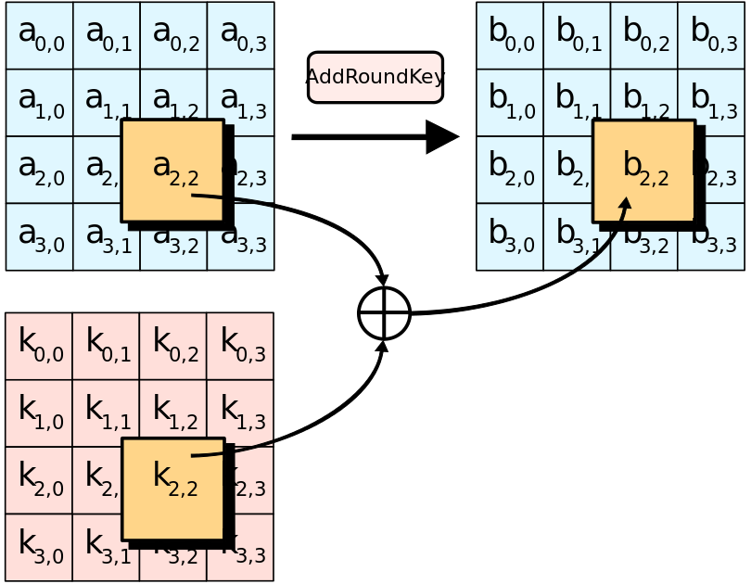
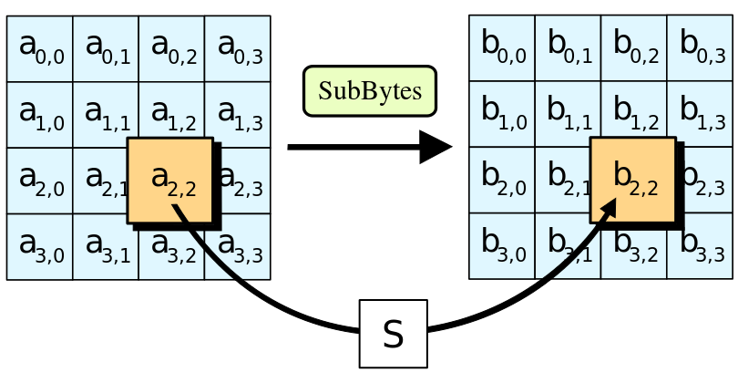
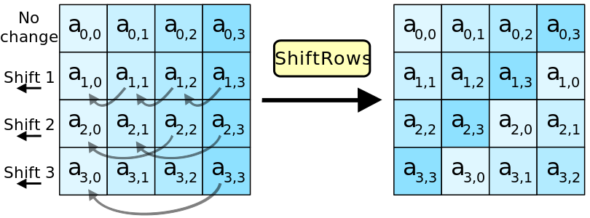
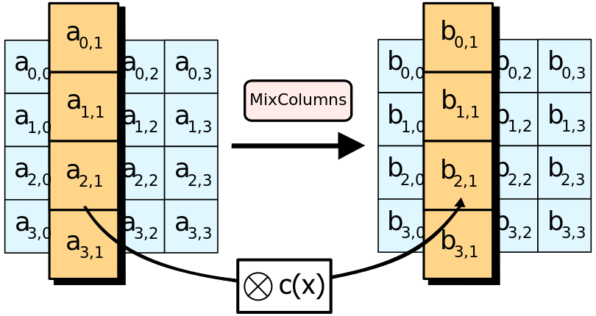
AES
http://en.wikipedia.org/wiki/Advanced_Encryption_Standard
AddRoundKey
KeyExpansion
Round keys are derived from the cipher key using Rijndael's key schedule
InitialRound
AddRoundKey: state is XOR'ed with the round key
Rounds
SubBytes: each byte is replaced with another according to a lookup table
ShiftRows: last three rows of the state are shifted cyclically
MixColumns: columns are combined using an invertible linear transformation
AddRoundKey
Final Round
SubBytes
ShiftRows
AddRoundKey
SubBytes
ShiftRows
Mixcolumns

Slide 13
Conventional Encryption Algorithms
Algorithm | Key Size | Number of Rounds | Mathematical Operations | Applications
DES | 56 Bits | 16 | XOR, fixed S-boxes | Kerberos
Triple DES | 112 or 168 Bits | 48 | XOR, fixed S-boxes | Financial Key PGP S/MIME
IDEA | 126 | 16 | XOR, variable S boxes, add
Blowfish | 40 - 448 | 16 | Add. Sub. XOR, rotation
CAST-128 | 40 to 128 bits | 16 | Add. Sub. XOR, fixed S-boxes | PGP
AES | 128, 192, 256 | 10, 12, 14 | XOR, rotate, fixed S-boxes, matrix ops | GPG Ipsec SPARC S3
Notes:
Triple DES can have a key length 0f 56, 112, or 168 bits, because all 3 keys can be independent or identical.

Slide 14
Public Key Cryptography
Two keys
Private key known only to individual
Public key available to anyone
Public key, private key inverses
Idea
Confidentiality: encipher using public key, decipher using private key
Integrity/authentication: encipher using private key, decipher using public one

Slide 15
Requirements
Computationally easy to encipher or decipher a message given the appropriate key
Computationally infeasible to derive the private key from the public key
Computationally infeasible to determine the private key from a chosen plaintext attack

Slide 16
RSA
History
1977 MIT
Ron Rivest, Adi Shamir and Leonard Adleman
Exponentiation cipher
meaning, relies on the difficulty of determining the number of numbers relatively prime to a large integer n
Asymmetric approach involving 3 parts
key generation
encryption
decryption

Slide 17
But first, a word from Euler
Totient function φ(n)
Number of positive integers less than n and relatively prime to n
Relatively prime means with no factors in common with n
Example: φ(10) = 4
1, 3, 7, 9 are relatively prime to 10
approach: 10 is factored as 2 x 5; remove all multiples of 2 and 5
1 2 3 4 5 6 7 8 9
Example: φ(21) = 12
1, 2, 4, 5, 8, 10, 11, 13, 16, 17, 19, 20 are relatively prime to 21

Slide 18
Algorithm
Choose two large prime numbers p, q
Let n = pq; then φ(n) = (p–1)(q–1)
Choose e < n such that e is relatively prime to φ(n).
Compute d such that ed mod φ(n) = 1
Public key: (e, n); private key: d
Encipher: c = m^{e} mod n
Decipher: m = c^{d} mod n

Slide 19
Example: Confidentiality
Let p = 7, q = 11,
so n = 77 and φ(n) = 60
Alice chooses e = 17, making d = 53
Bob wants to send Alice secret message HELLO (07 04 11 11 14)
Encryption using Alice's public key:
07¹⁷ mod 77 = 28
04¹⁷ mod 77 = 16
11¹⁷ mod 77 = 44
11¹⁷ mod 77 = 44
14¹⁷ mod 77 = 42
Bob sends 28 16 44 44 42

Slide 20
Example
Alice receives 28 16 44 44 42
Alice uses private key, d = 53, to decrypt message:
28⁵³ mod 77 = 07
16⁵³ mod 77 = 04
44⁵³ mod 77 = 11
44⁵³ mod 77 = 11
42⁵³ mod 77 = 14
Alice translates message to letters to read HELLO
No one else could read it, as only Alice knows her private key and that is needed for decryption

Slide 21
Example: Integrity/Authentication
Take p = 7, q = 11
so n = 77 and φ(n) = 60
Alice chooses e = 17, making d = 53
Alice wants to send Bob message HELLO (07 04 11 11 14) so Bob knows it is what Alice sent (no changes in transit, and authenticated)
encrypted using private key
07⁵³ mod 77 = 35
04⁵³ mod 77 = 09
11⁵³ mod 77 = 44
11⁵³ mod 77 = 44
14⁵³ mod 77 = 49
Alice sends 35 09 44 44 49

Slide 22
Example
Bob receives 35 09 44 44 49
Bob uses Alice’s public key, e = 17, n = 77, to decrypt message:
35¹⁷ mod 77 = 07
09¹⁷ mod 77 = 04
44¹⁷ mod 77 = 11
44¹⁷ mod 77 = 11
49¹⁷ mod 77 = 14
Bob translates message to letters to read HELLO
Authentication: He knows Alice sent it because she used her private key
Integrity: The message would not decrypt properly if it had been altered in transit

Slide 23
Example: Both
Alice wants to send Bob message HELLO both enciphered and authenticated (integrity-checked)
Alice’s keys: public (17, 77); private: 53
Bob’s keys: public: (37, 77); private: 13
Alice enciphers HELLO (07 04 11 11 14):
(07⁵³ mod 77)³⁷ mod 77 = 07
(04⁵³ mod 77)³⁷ mod 77 = 37
(11⁵³ mod 77)³⁷ mod 77 = 44
(11⁵³ mod 77)³⁷ mod 77 = 44
(14⁵³ mod 77)³⁷ mod 77 = 14
Alice sends 07 37 44 44 14

Slide 24
Security Services
Confidentiality
Only the owner of the private key knows it, so text enciphered with public key cannot be read by anyone except the owner of the private key
Authentication
Only the owner of the private key knows it, so text enciphered with private key must have been generated by the owner
Integrity
Enciphered letters cannot be changed undetectably without knowing private key
Non-Repudiation
Message enciphered with private key came from someone who knew it

Slide 25
Warnings
Encipher message in blocks considerably larger than the examples here
If 1 character per block, RSA can be broken using statistical attacks (just like classical cryptosystems)
Attacker cannot alter letters, but can rearrange them and alter message meaning
Example: reverse enciphered message of text ON to get NO

Slide 26
Cryptographic Checksums
Mathematical function to generate a set of k bits from a set of n bits (where k ≤ n).
k is smaller then n except in unusual circumstances
Example: ASCII parity bit
ASCII has 7 bits; 8th bit is “parity”
Even parity: even number of 1 bits
Odd parity: odd number of 1 bits

Slide 27
Example Use
Bob receives “10111101” as bits.
Sender is using even parity; 6 1 bits, so character was received correctly
Note: could be garbled, but 2 bits would need to have been changed to preserve parity
Sender is using odd parity; even number of 1 bits, so character was not received correctly

Slide 28
Desired Characteristics
Easy to compute the hash value for any given message
Infeasible to generate a message from given hash
Infeasible to modify a message without changing the hash
Infeasible to find two different messages with the same hash.
Pigeonhole principle: if there are n containers for n+1 objects, then at least one container will have 2 objects in it.
Example: if there are 32 files and 8 possible cryptographic checksum values, at least one value corresponds to at least 4 files

Slide 29
Keyed vs Keyless
Keyed cryptographic checksum: requires cryptographic key
DES in chaining mode: encipher message, use last n bits. Requires a key to encipher, so it is a keyed cryptographic checksum.
Keyless cryptographic checksum: requires no cryptographic key
MD5 and SHA-1 are best known; others include MD4, HAVAL, and Snefru

Slide 30
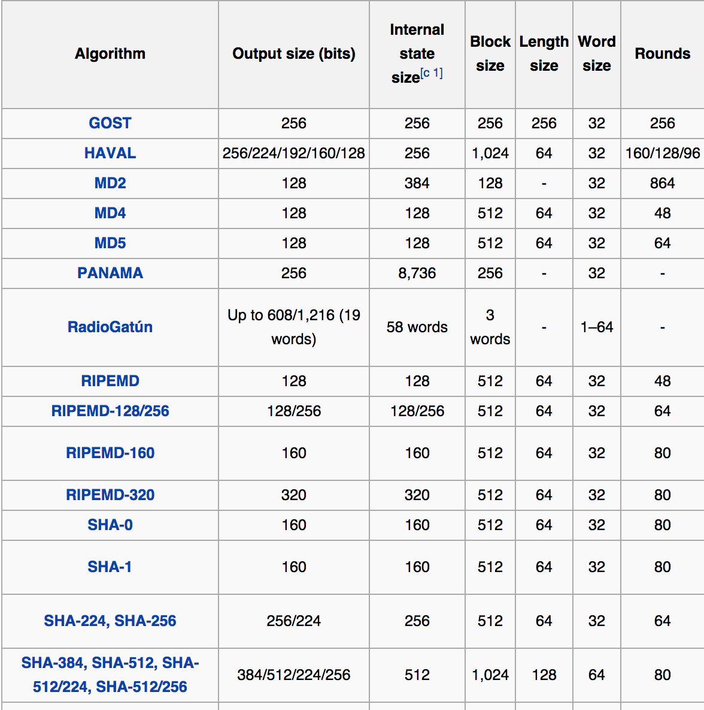
http://en.wikipedia.org/wiki/Cryptographic_hash_function

Slide 31
MD5
Developed by Rivist (the "R" of RSA)
Cryptographic hash function that produces a 128-bit (16-byte) hash value
typically expressed in text format as a 32 digit hexadecimal number
Commonly used to verify data integrity.
Example:
MD5("The quick brown fox jumps over the lazy dog")
9e107d9d372bb6826bd81d3542a419d6
MD5("The quick brown fox jumps over the lazy dog.")
e4d909c290d0fb1ca068ffaddf22cbd0

Slide 32
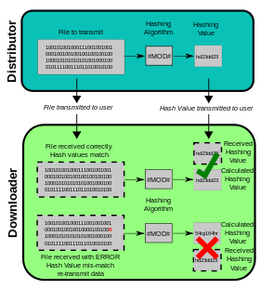

Slide 33
Location of Encryption Device
Link encryption:
A lot of encryption devices
High level of security
Decrypt each packet at every switch
End-to-end encryption
The source encrypt and the receiver decrypts
Payload encrypted
Header in the clear
High Security: Both link and end-to-end encryption are needed
Notes:
Additional Content from text:
Public Key Cryptography
Uses two keys – public and private. This removes the requirement that the sender and recipient share a common key.
RSA is an example of an encryption technique that uses public keys
Steps of RSA encryption
Find Totient – choose two large prime numbers p and q, and let n = pq. The totient φ(n) of n is the number of numbers less than n with no factors in common with n.
Ex if p = 5 and q = 3, then n = 15 and φ(n) = 8 (1, 2, 4, 7, 8, 11, 13, 14)
Choose an integer e < n that is relatively prime to φ(n). Find a second integer d such that ed % φ(n) = 1. Then the public key is (e, d) and the private key is d.
To encrypt/decrypt a message m
c = m^{e} % n
m = c^{d} % n
Continuing above example, to encrypt the message “HI”
Choose e = 3, d = 3
“H” is the 8th letter of the alphabet, “I” is the 9th
c₁ = 8³ % 15 = 2
c₂ = 9³ % 15 = 9
So the message is encrypted as “02 09”
m₁ = 2³ % 15 = 08 = “H”
m₂ = 9³ % 15 = 09 = “I”
In practice, larger numbers should be chosen, so as to increase the range of encrypted values.
Cryptographic Checksums:
Used to verify the integrity of a message
When recipient gets message and checksum, he re-computes checksum and compares
A simple checksum can be computed with parity bits
Many checksums use hashes. Examples include MD5, SHA, and HMAC. These can be keyed or keyless hash functions.
Link encryption is implemented in the lowest network layer. It involves encrypting header and payload information, but is vulnerable at each node because it is unencrypted. It is also expensive computationally, requiring each switch to implement encryption and decryption. End-to-end encryption involves payload for the entirety of the transfer, but unencrypted header information such as source and address leave it vulnerable to passive attacks.

Slide 34
Key Points
Two main types of cryptosystems: classical and public key
Classical cryptosystems encipher and decipher using the same key
Or one key is easily derived from the other
Public key cryptosystems encipher and decipher using different keys
Computationally infeasible to derive one from the other
Cryptographic checksums provide a check on integrity

Slide 35
RSA
#!/usr/local/bin/perl -s-- #export-a-crypto-system sig, RSA in 4 lines PERL:
$e-$d&(($k,$n)=@ARGV)==2||die"$0 -d|-e key mod out\n";$v=$w=1+length$n&
~1;$v-=$d*2;$w-=$e*2;$_= unpack('B*', pack('H*',1$k?"0$k":$k));s/^0+//;
s/1/0lM*ln%/g;s/0/d*ln%/g; while(read(STDIN,$m,$w/2)){$m=unpack("H$w",$m);$a=
`echo 16oOi\U$m SM$n\Esn1$_ p|dc`;print pack("H$v",'0'x($v+1-length$a).$a);}

Slide 36
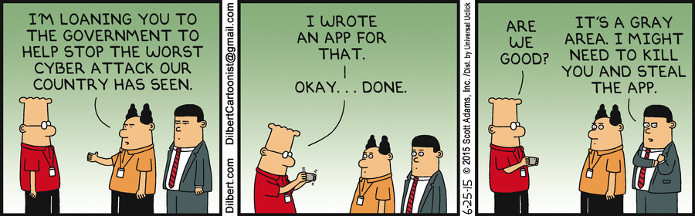
Final thoughts for today
http://dilbert.com/search_results?terms=Hacker

